Slide 1
Creative Coding Club
Free IoT Practical Coding Workshop 2

Slide 2
Club Meetups
Fortnight free workshops
Investable training:
Beginning Arduino
Internet of Things with ESP8266
Python
Web development
Hackathons

Slide 3
Meetup Hosts
Dipto Pratyaksa
Raymond Chan
You?

Slide 4
How are we different?
No specific technology / platform
Very practical, focus on software development side of things
A coding dojo.

Slide 5
Past Meetups
11/2/2018 Code Anything You Can Think Of
25/2/2018 Free Arduino and IoT practical programming workshop 1

Slide 6
Today's Agenda
Free Arduino and IoT practical programming workshop 2
1.00 intro and ice breaker
1.15 talks on arduino code overview
1.30 talks on sending data wirelessly
1.45 components protoyping
2.00 beer theft coding challenge
2.45 group presentations
3.00 pack up and goodbye

Slide 7
House Keeping
Emergency Exit
Safety:
Never short-circuit: Red wire + black wire = FIRE!
Reverse polarity = FRIED BOARD
Always disconnect when you tinker with electronics
Check and double check your wiring
In case of incident, switch off power supply, ask for help

Slide 8
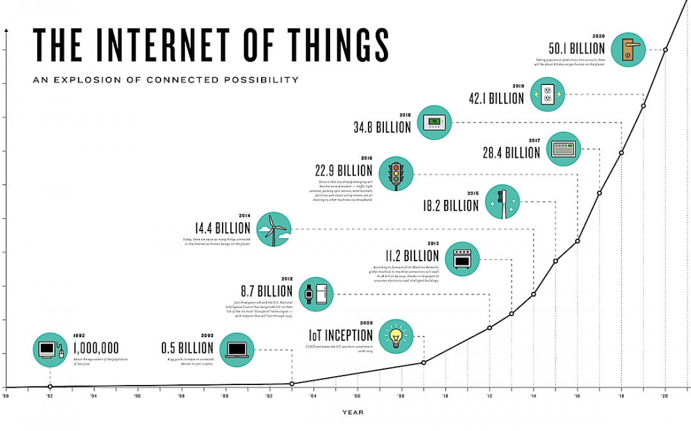

Slide 9
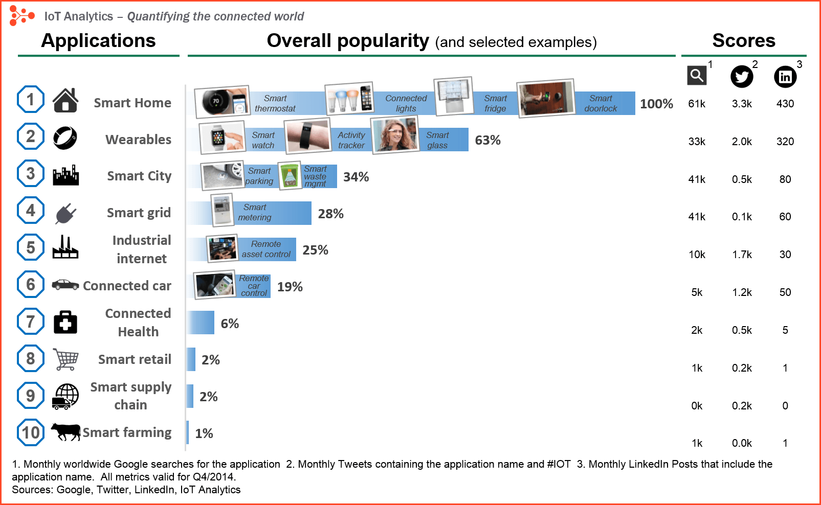

Slide 10
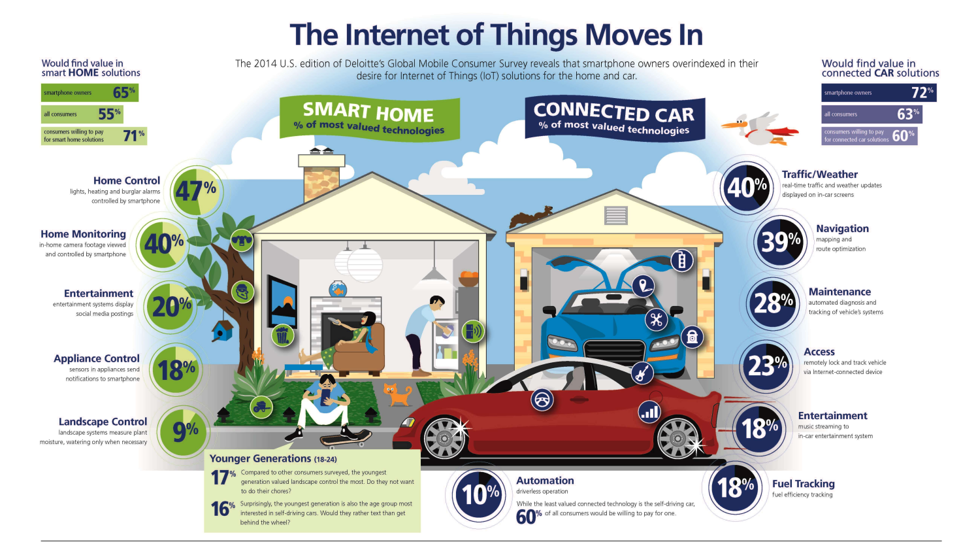
Source: Deloitte website

Slide 11
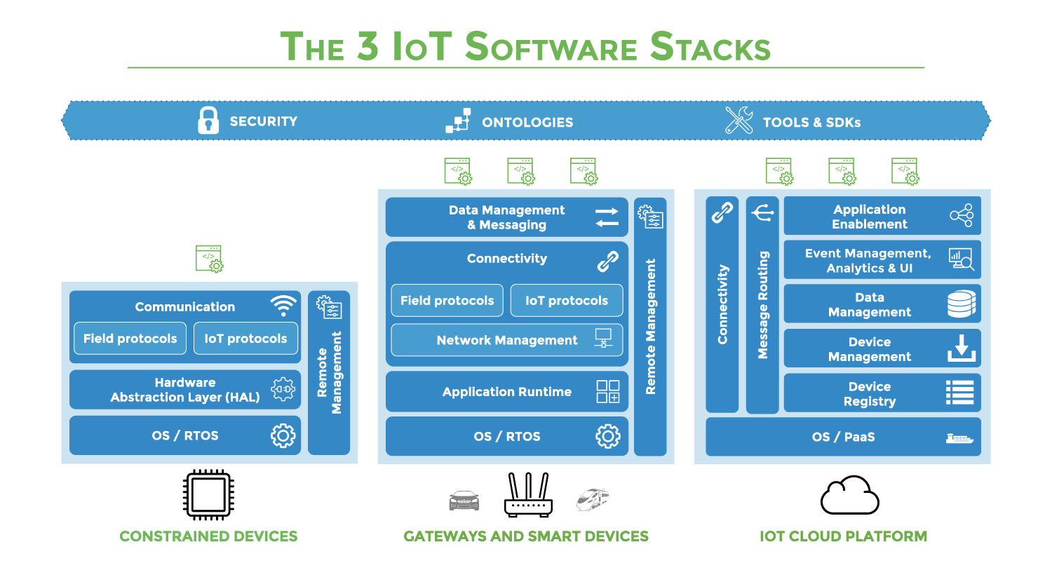

Slide 12
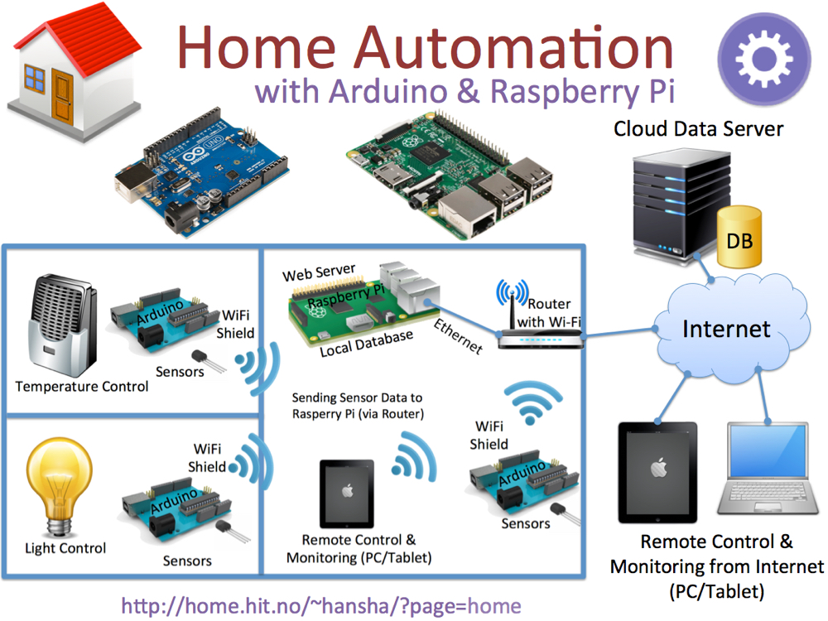

Slide 13
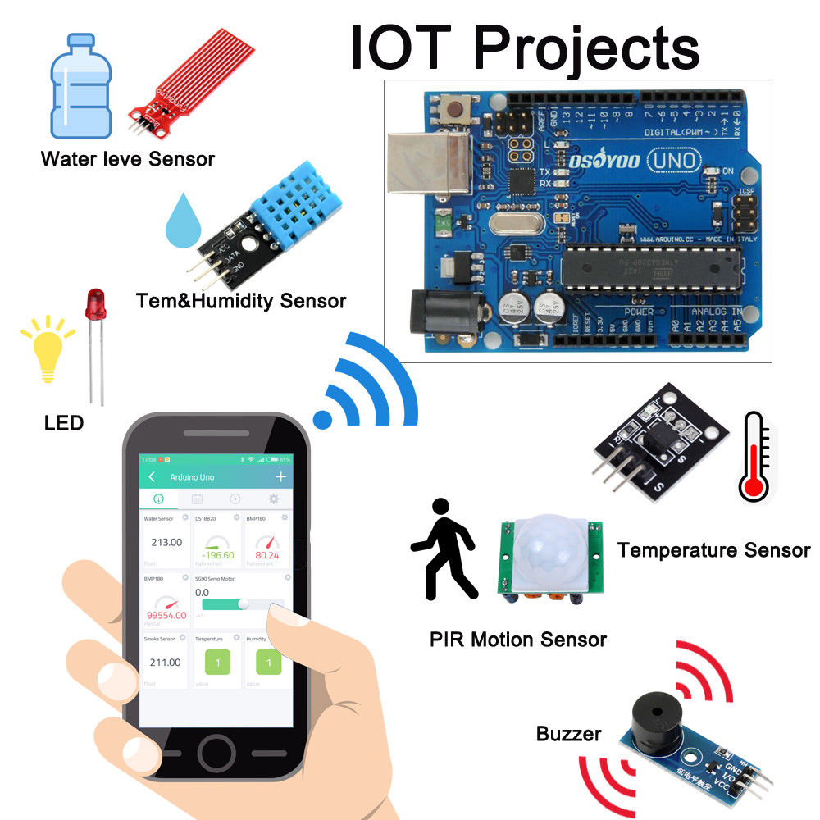

Slide 14
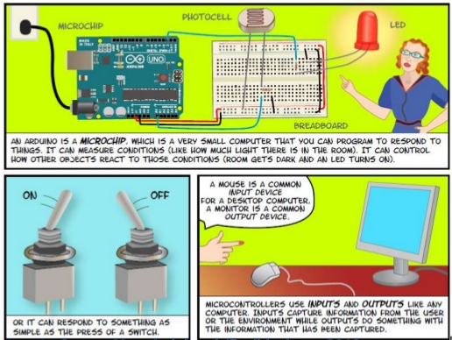

Slide 15
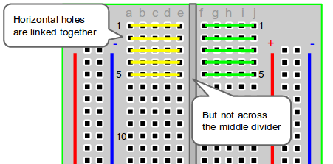
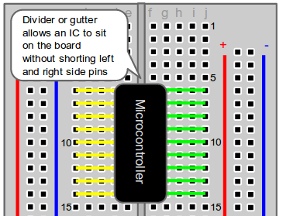
The Breadboard - Horizontal Columns

Slide 16
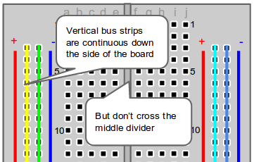
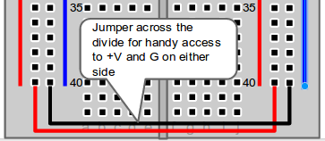
The Breadboard - Vertical Columns

Slide 17
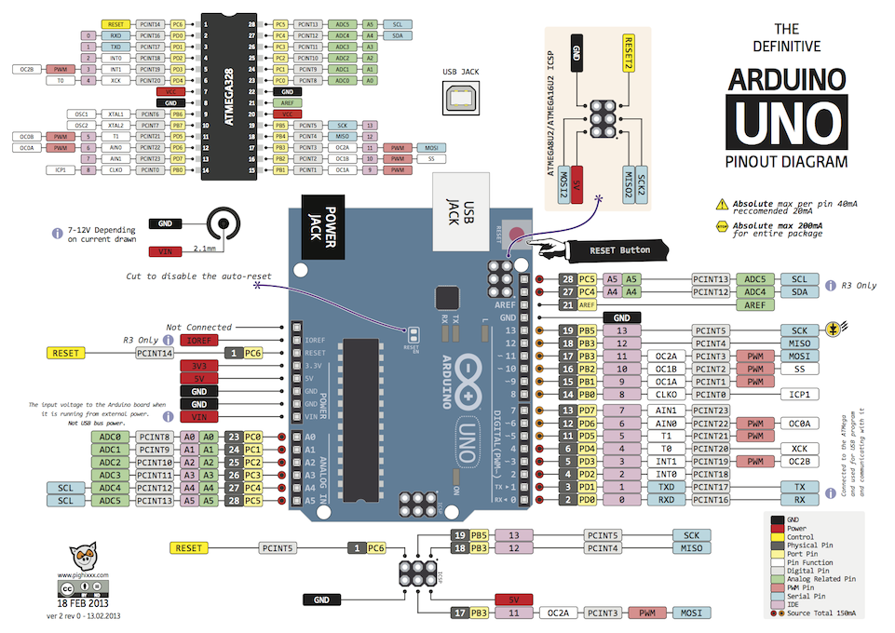

Slide 18
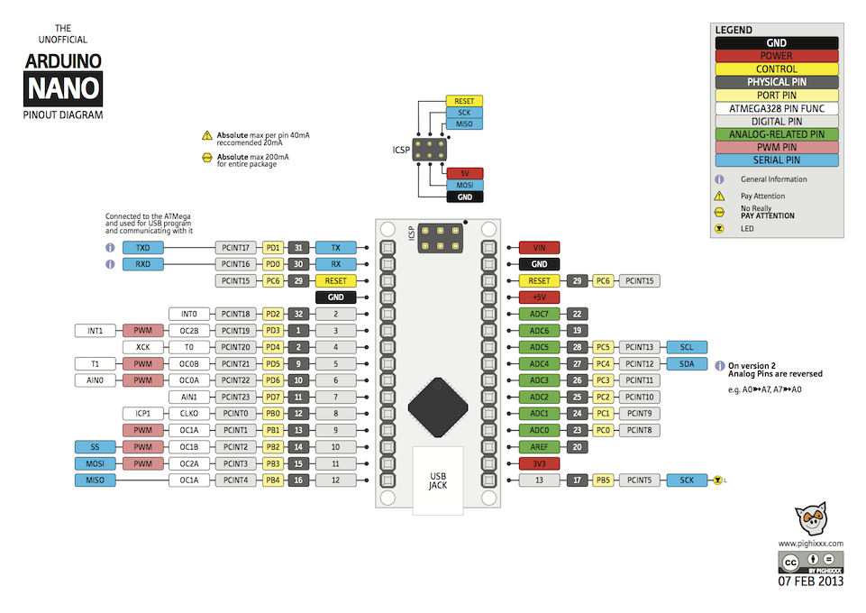

Slide 19
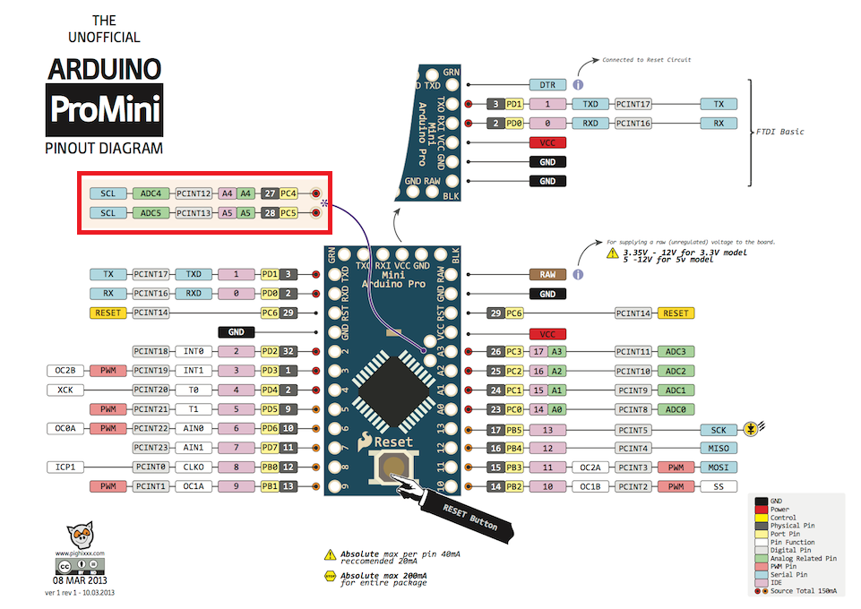

Slide 20
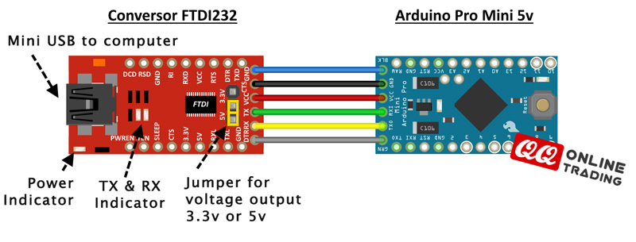
Uploading onto ProMini - FTDI232 programmer

Slide 21
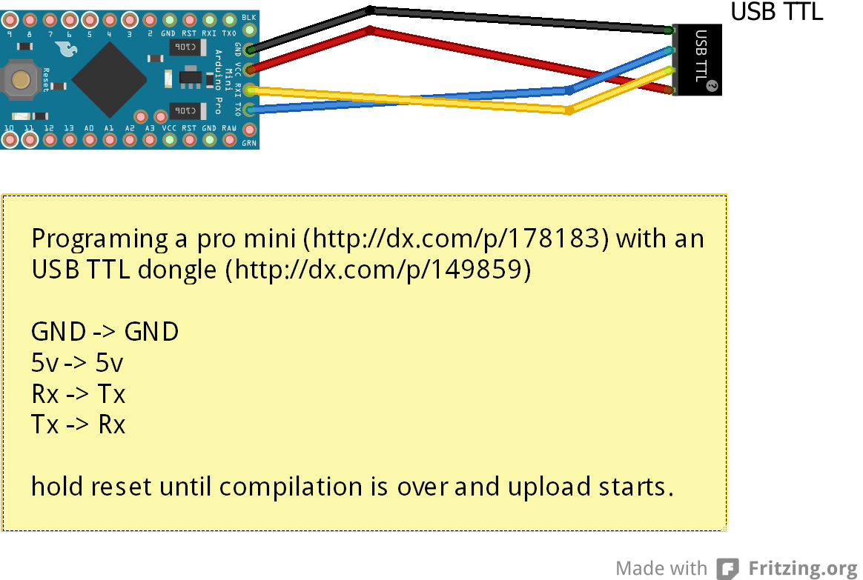
Uploading onto ProMini - USB TTL dongle

Slide 22
Code Overview
Arduino Sketch
A sketch is the name that Arduino uses for a program. It's the unit of code that is uploaded to and run on an Arduino board.
C/C++ codes with pre-built libraries
https://www.arduino.cc/en/Tutorial/Sketch
Arduino Genuino IDE
Code
Verify
Upload
https://www.arduino.cc/en/Guide/Environment

Slide 23
Typical code structure
setup()
loop()

Slide 24
Arduino Serial Communications
How to 'talk' to this thing?
http://www.ladyada.net/learn/arduino/lesson4.html

Slide 25
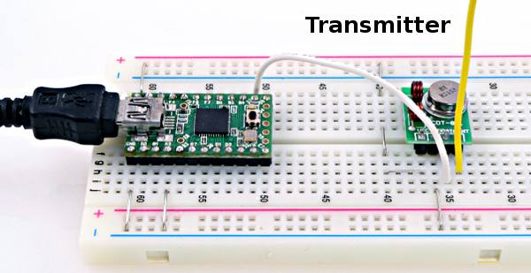
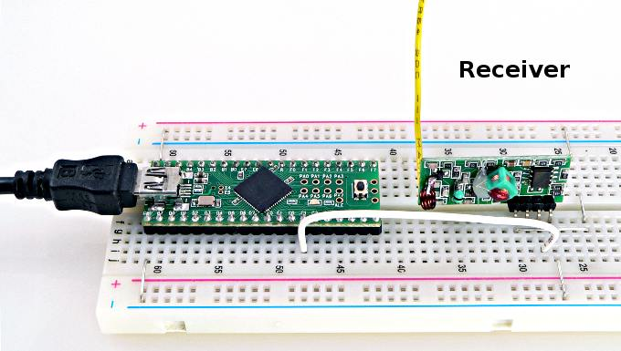
Sending data wirelesly: RF
RF transmitter and receiver 433Hz

Slide 26
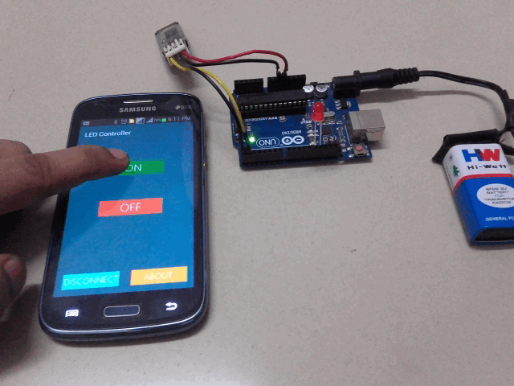
Sending data wirelesly: Bluetooth

Slide 27
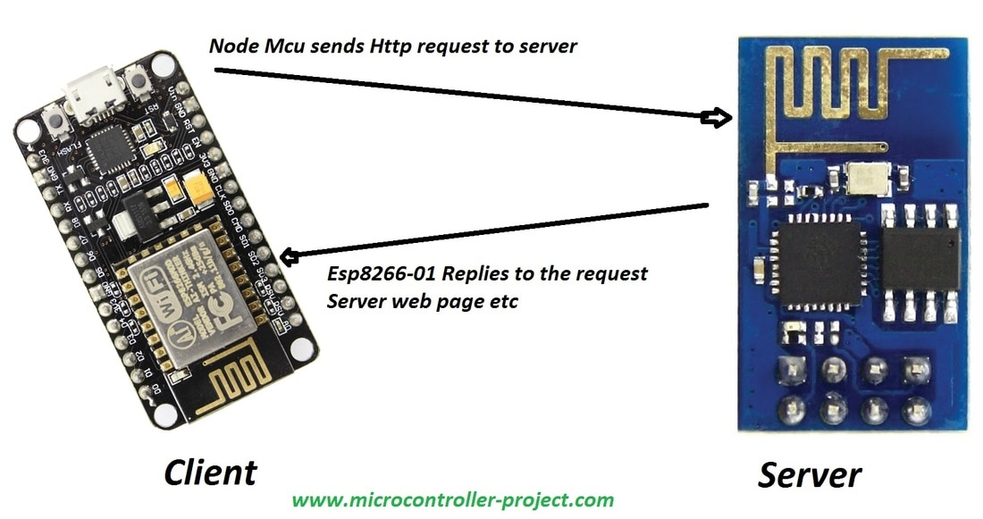
Sending data wirelesly: Wifi

Slide 28
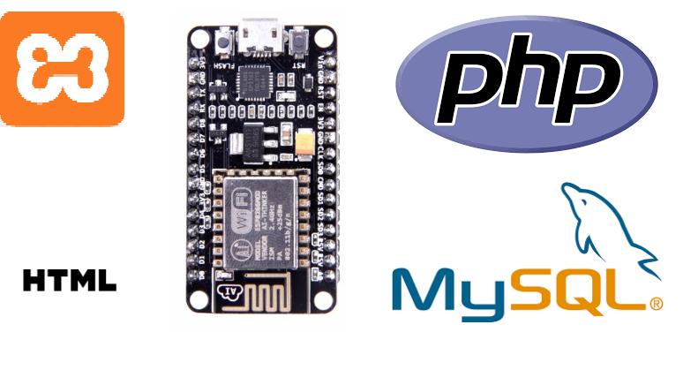
Open-source and open hardware IoT solutions

Slide 29
Let's get coding
1. Blink a LED
2. Push button
3. Light sensor
4. Buzz a buzzer
Guides and References are on Discussions page:
https://www.meetup.com/CreativeCodingClub-MelbourneSouthEasternSuburbs/messages/boards/thread/51456035/0#131144363

Slide 30
Coding Challenge: BEER THEFT DETECTOR
You live in a shared accomodation, where you share a fridge with 3 others. You want to build a simple, offline Internet of Thing to detect and alert you when someone is stealing your beer.
How do you use Arduino, LED, a button, a buzzer, and a light sensor to design and build a BEER THEFT alarm?

Slide 31
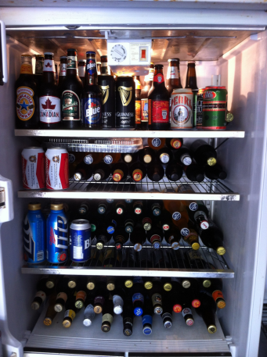
Yesterday...

Slide 32
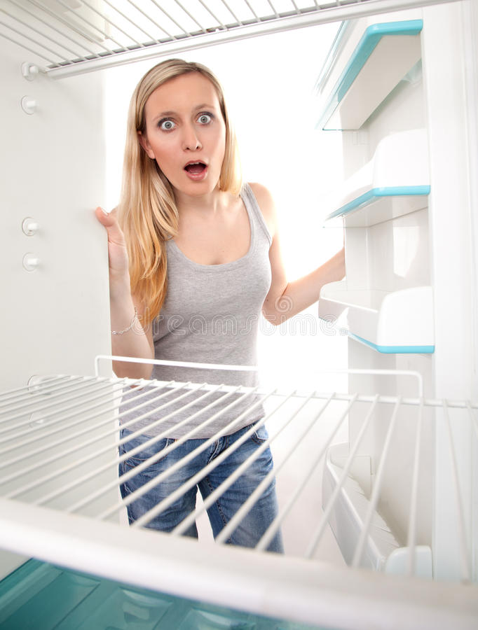
Today...

Slide 33
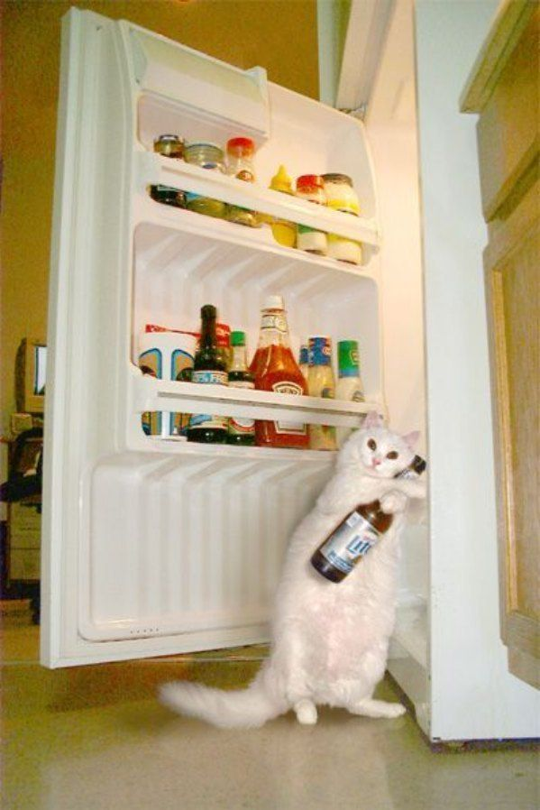
(Un)usual suspect

Slide 34
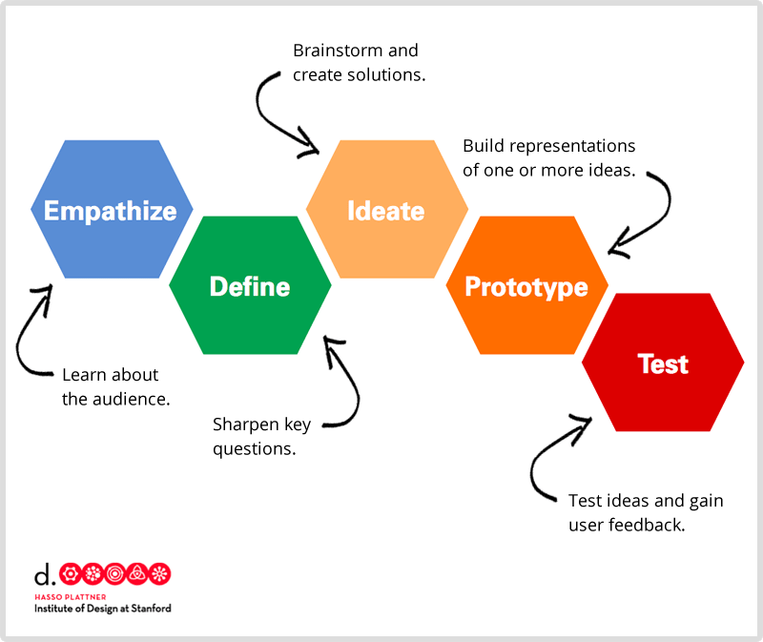

Slide 35
Emphatise = Understand the problem
Ok, she got big issue with not having enough beer
We could imagine how she feels
Target persona = Michelle, college age, female, need stock of beers to survive the semester

Slide 36
Define = Analyse, Interpret, Plan
Need: Simple alarm that will alert beer owner when a bottle gets stolen
Constraints:
Done in 1 hour
Limited components
Beginning-advanced coding skills
Basic knowledge on Arduino, electronics prototyping
The plan:
Team of 2
Install hardware and components: 0.5 hour
Code them up: 0.5 hour

Slide 37
Ideate = Imagine, Research, Ponder
Invent / develop a product that will solve Michelle's problem
Arduino based offline solution
Potential extension for wireless connectivity
How will it work?
When someone opens the fridge door, blink the LED
When someone lift a beer bottle, ring the buzzer
How will it look like?

Slide 38
Prototype = Apply creativity to create
Hardware Design:
1 Arduino board of any type
2 actuators: buzzer and LED
2 sensors: photoresistor (LDR), push button
1 breadboard
few wires
few resistors

Slide 39
Prototype = Apply creativity to create
Software design and algorithm
Event | Stimuly | Response
Fridge light is on | detect light intensity with LDR | if light intensity is high activate LED blink once every second
Bottle is being lifted | detect button unpressed | if button is not pressed activate buzzer buzz once every two seconds

Slide 40
Test = Review and revise
Press button
Unpress button
Cover LDR
Uncover LDR
Test beep
Test blink
Combine them all and retest

Slide 41
Present

Slide 42
Reference and resources
Arduino and circuits
https://www.allaboutcircuits.com/projects/learn-how-to-use-the-arduinos-digital-i-o/
https://www.makeuseof.com/tag/getting-started-with-arduino-a-beginners-guide/
https://computers.tutsplus.com/tutorials/how-to-use-a-breadboard-and-build-a-led-circuit--mac-54746
www.Arduino.cc
Design thinking process:
https://www.youtube.com/watch?v=qyoZTUGzdGY

Slide 43
Next Meetup
Sunday 25 March 1-3pm
OfficeWorks Carnegie
Topics:
Further wireless communications
Connecting ESP8266 with a mobile phone

